Slide 1
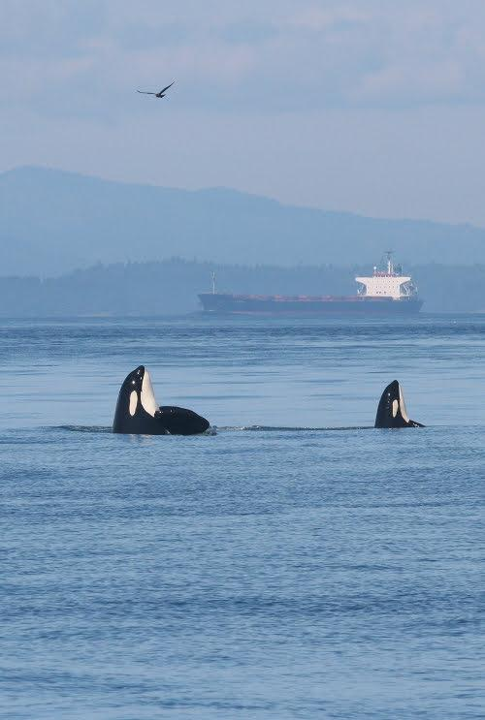

open source software for catalyzing conservation of
Southern Resident killer whales (in real-time)
Scott Veirs & Val Veirs on behalf of the Orcasound community
sveirs@ gmail.com | Orcasound Slack
orcasound.net/talks
Notes:
Good afternoon and thank you kindly for the opportunity speak in-person today on behalf of the orcasound hydrophone network and open source community. Far too many good people have contributed to this effort today than I could enter in the ASA author form, so I’ll do my best to acknowledge them during the talk. If you're in the back of the room realizing (like me) that your eyesight has worsened during he covid pandemic, our slides are available at this URL -- orcasound.net/talks. You can use this Google slide deck to explore the links I’ll demo today and even join our community by clicking on this yellow underlined link which leads to our open Slack workspace. My goal is to give you a tour of how we are trying to give SRKWs a voice in their conservation -- which is complex and possesses at least 2 challenges.

Slide 2
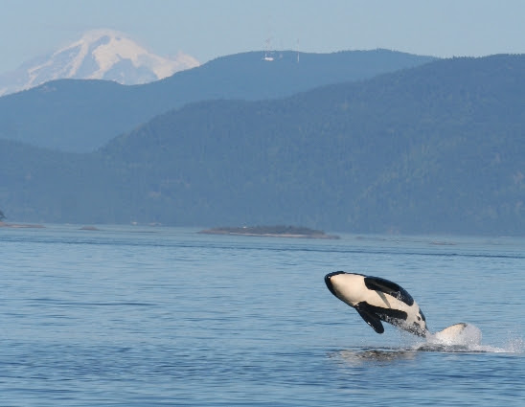
Our orcas: the southern salmon seekers
Southern Resident Killer Whales (SRKWs) are:
Southern = ranging from northern California to SE Alaska
Resident = historically re-occurring within the Salish Sea (inland waters of WA and BC)
Killer = apex predators, salmon specialists
Whales = cultural icons, both historically & as modern “charismatic megafauna”
How can we collaborate across State and International boundaries to conserve these orcas?
Notes:
A first part of our challenge and opportunity is geographic. The SRKWs seek salmon along much of the west coast. Part of this talk is an invitation to those of you from Oregon and California and Canada to join our mission to listen for these orcas and recover the endangered salmon runs they seek throughout their range -- much of which is now critical habitat in the U.S.

Slide 3
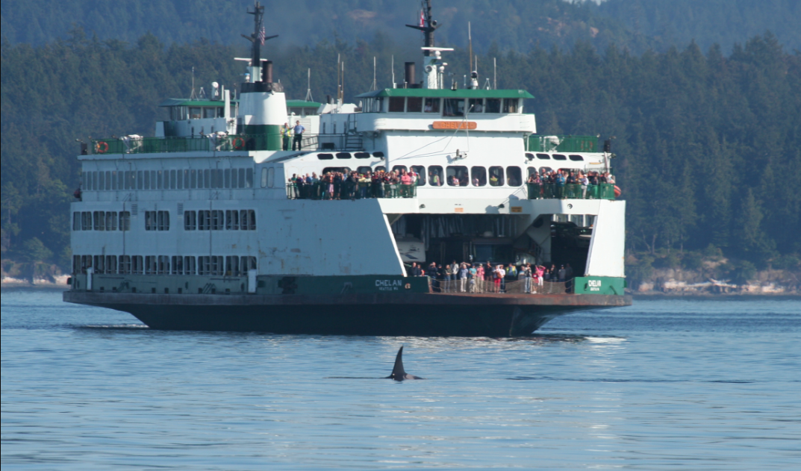
Our orcas: recovery by a 1000 actions
Cumulative human impacts
NOAA recovery plan
3 key risks:
  Scarce salmon
  Persistent pollutants in blubber
  Vessel effects
Vessel noise impacts:
  Ship noise masks communication & echolocation
  Boat interference lowers foraging efficiency
How can AI & human listeners work synergistically to conserve SRKWs (in real-time)?
Notes:
The second, bigger challenge is reducing all the threats they face over the long haul. As bioacousticians, many of us have been focused primarily on reducing vessel noise impacts in the short-term, which is a good strategy. However, I hope by the end of this talk that I’ll have convinced you we can also leverage the sounds orcas make to address the longer-term risks the face: low salmon supply and persistent pollutants. Can we parlay their potential “death by a thousand cuts” into recovery by a 1000 conservation actions -- per year, per day, or even per hour? Let me explain how we think AI and humans could accomplish this.

Slide 4
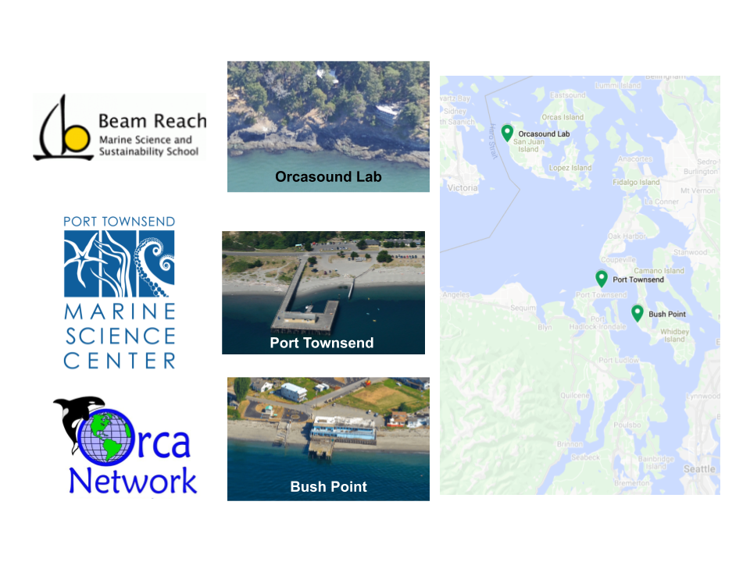
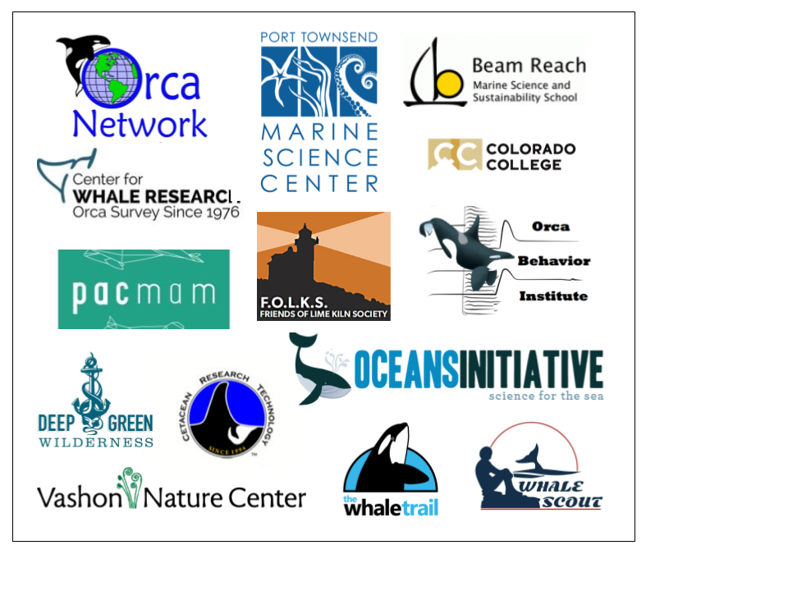
How? cooperate as a hydrophone network
2002: Orcasound Lab (Val’s “back yard”)
2008-12 NOAA funding (expansion to 5 nodes)
2013-15 Philanthropy only (decline to 2 nodes)
2016-now Cooperative network (17 NGOs in 2021)
2017 crowd-funding ($20k Kickstarter)
2018 open-sourcing, crowd-sourcing, open data...
2020+ hackathons, philanthropy, Amazon+Microsoft cloud credits
$$

Slide 5
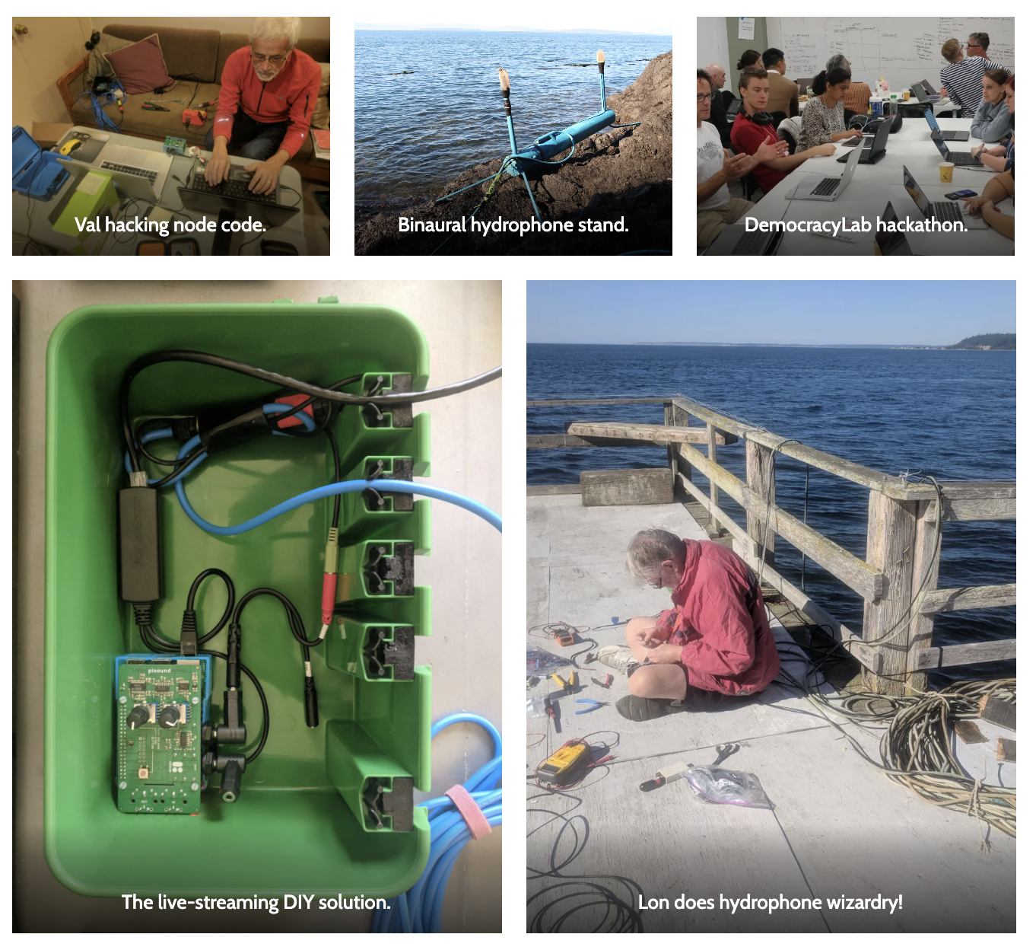
How? collaborate openly in soft/hard-ware
<2002-17
-- humans listening via Shoutcast mp3 streams
-- Val building custom software, alone
-- Scott building web static web sites, Google sheets, manual Twitter/email notifications...
2017-18: software + hardware (Kickstarter for v1 web app), live.orcasound.net launched Nov ‘18
2019-20: v2 UI beta-tested in Nov ‘19, launched in May, 2020
2021: v3 UI + a proliferation of related projects (24 public Orcasound Github repositories)

Slide 6
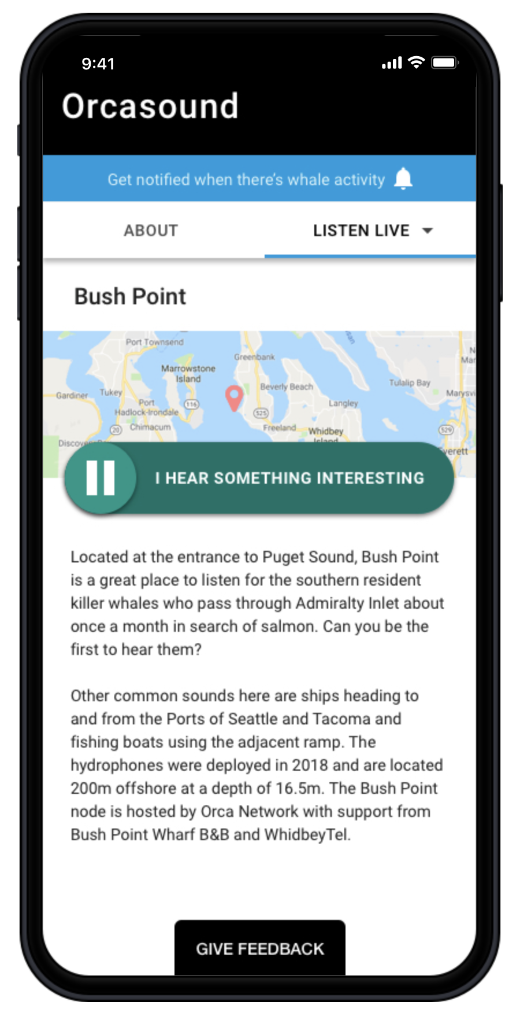
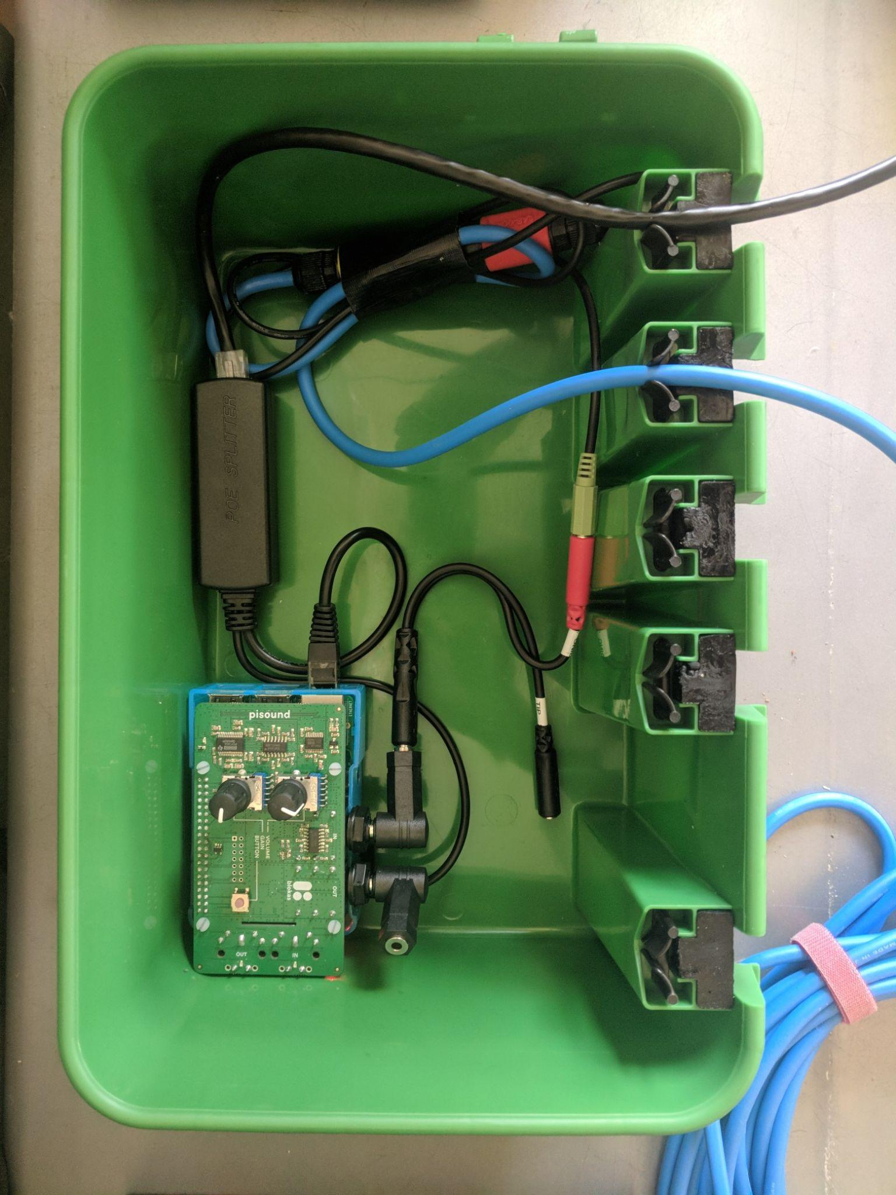

Easy to listen live. Scales inexpensively. Lets user tag data.
3 cabled nearshore sites streaming 24/7 (2018-21)
Streaming hardware cost: ~U$300 per node
Hydrophone $300-1500
PiSound HAT = 2 channel,
24 bit, 48/96/192 kHz
Free open source code!
Community scientists detect orca & novel sounds in real-time via a web app -- live.orcasound.net
Orca sounds
orcanode code
orcasite code

Slide 7
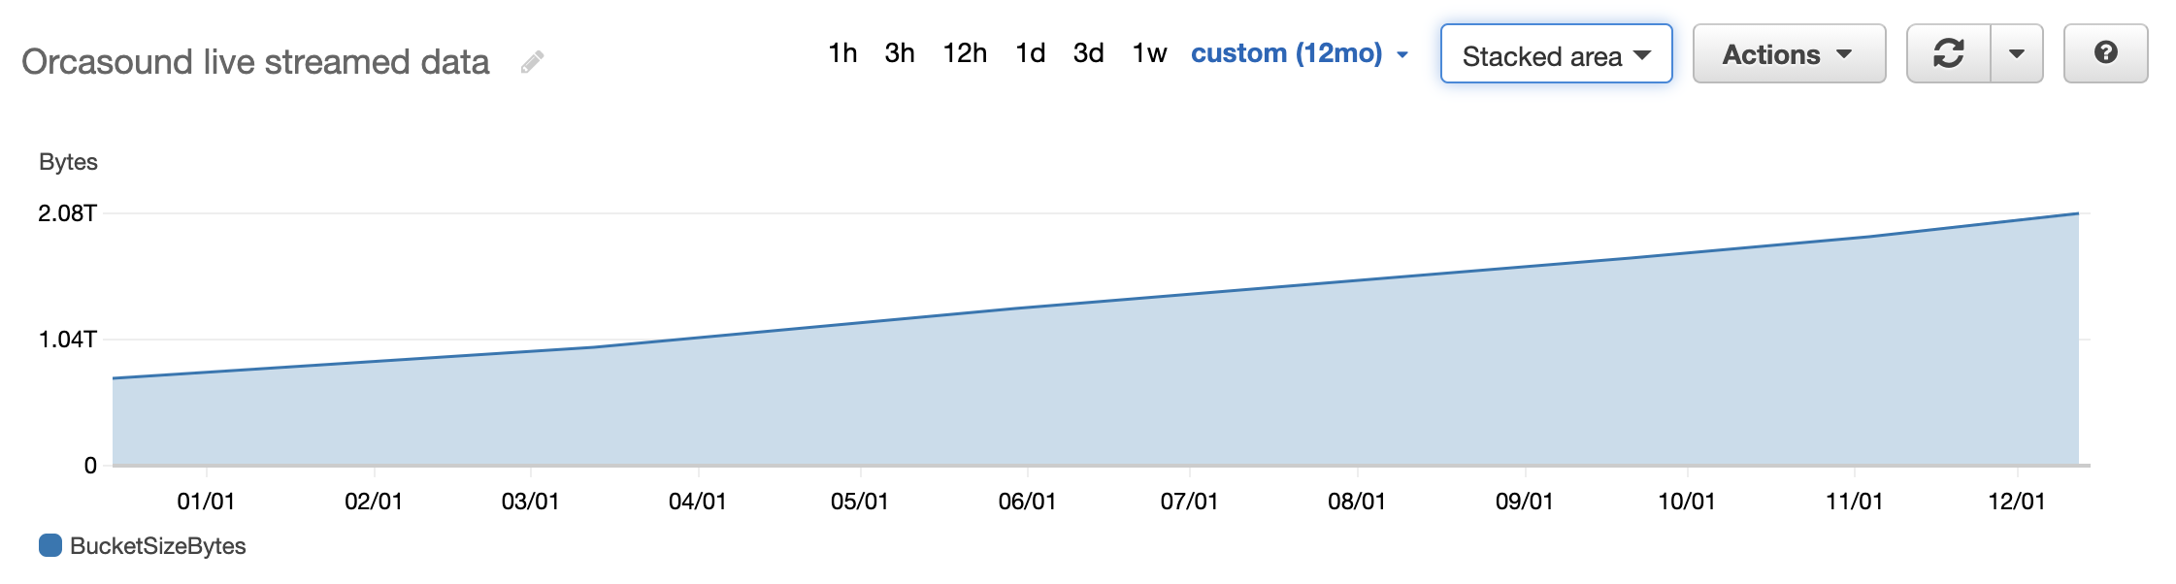
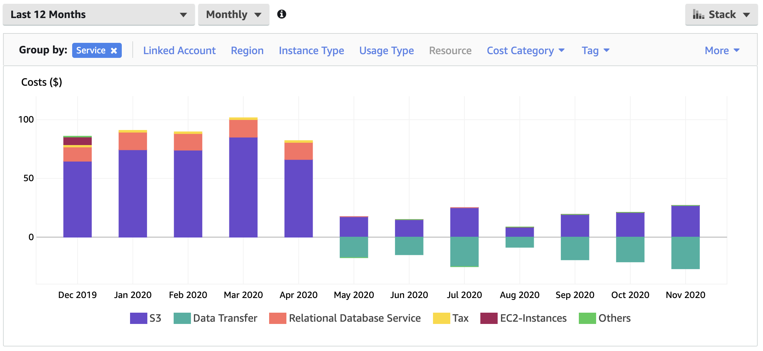
How? open access raw data
aws --no-sign-request s3 sync streaming-orcasound-net
Data volume
3.2 TB (HLS audio only)
0.4 TB/yr/node
Increasing soon...
...FLAC, 48/96 kHz
Data costs
<$100/mo w/3 nodes
~30$/mo/node, but scalable
Free thus far with cloud credits!
AWS open data registry + Quilt

Slide 8
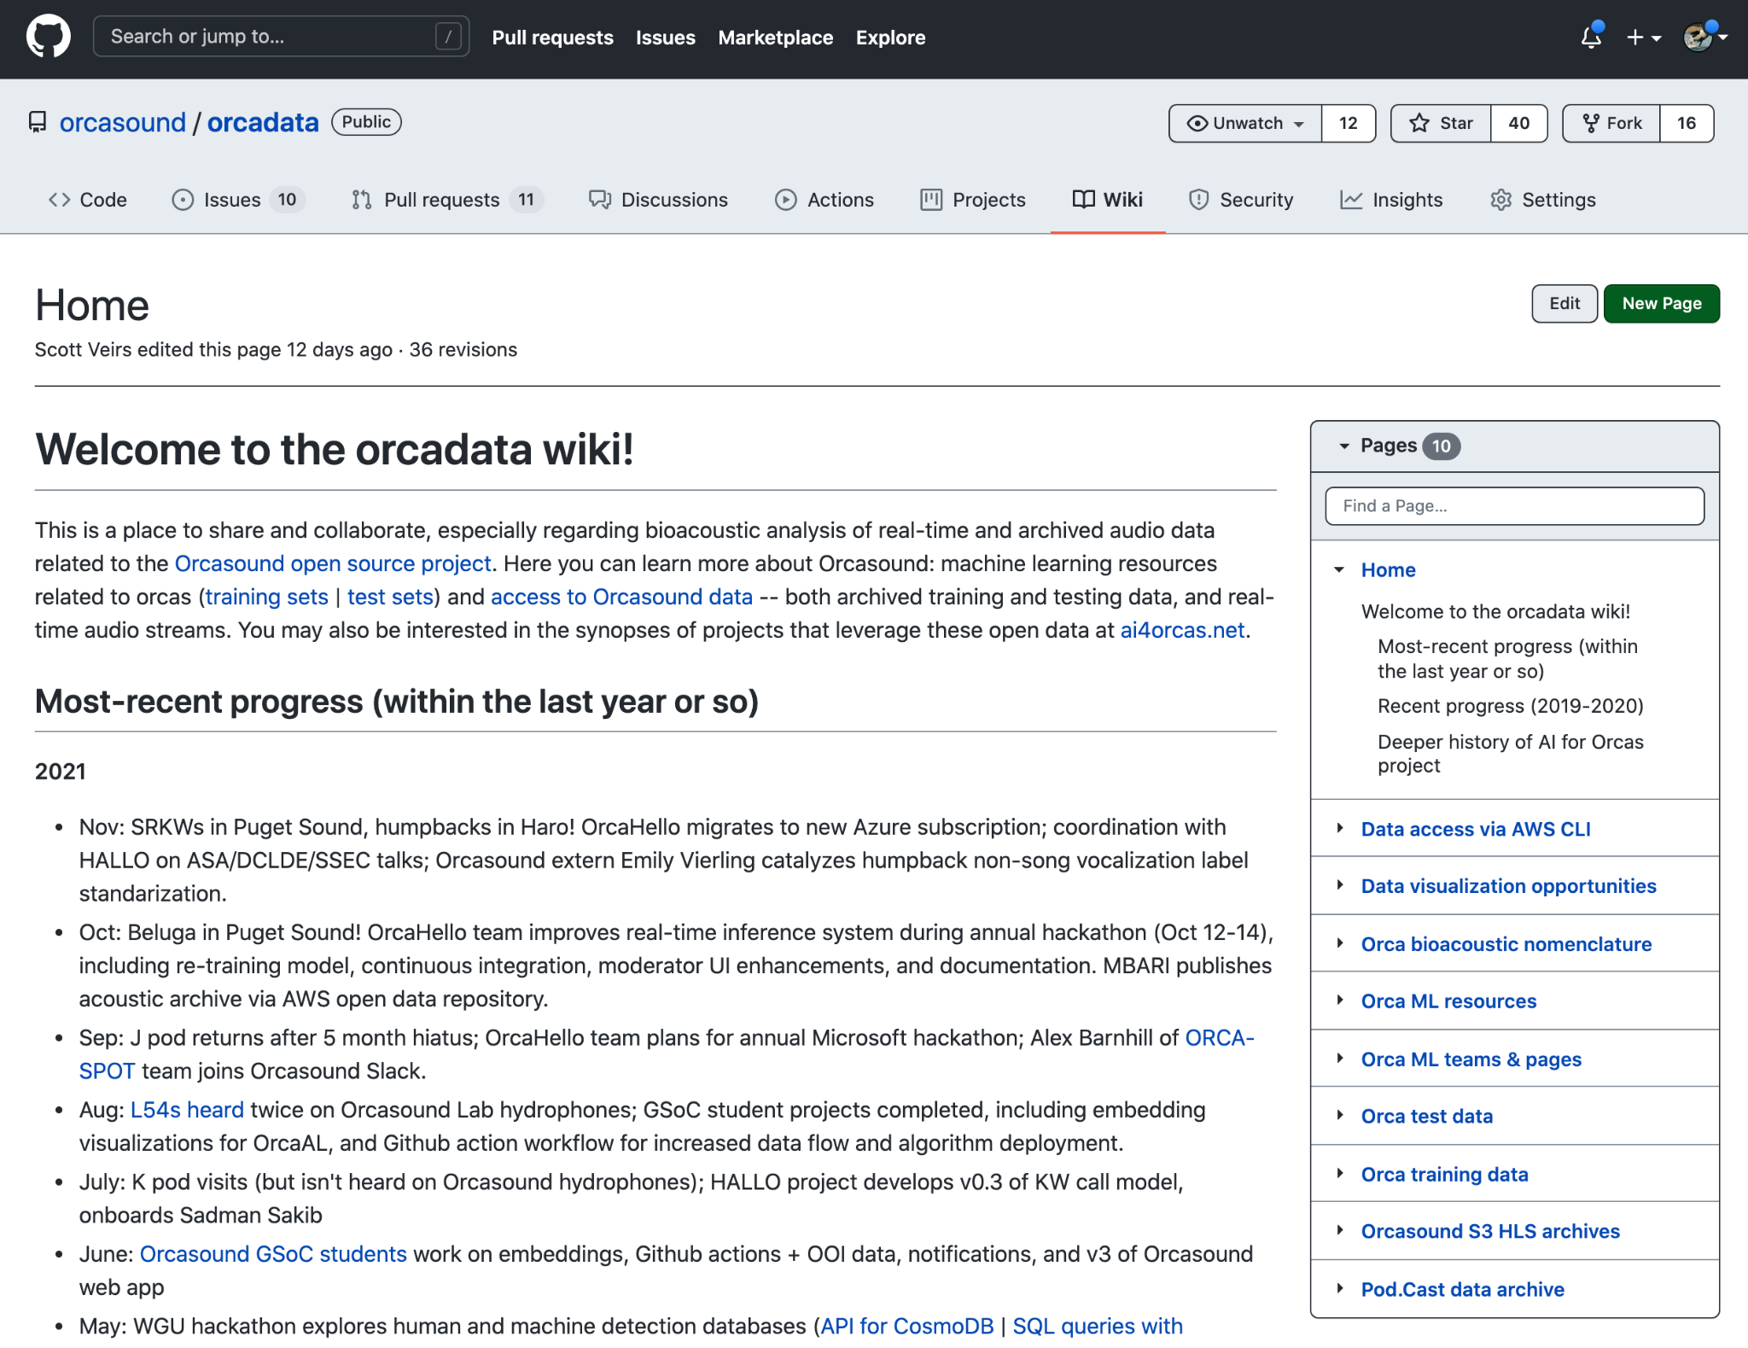
How? open labeled data & labeling tools
Labeled data (orcadata wiki)
SRKW calls
2022: signals of other SRKW sounds, Bigg’s KW, and humpback
Labeling tools
2000 Orcasound human labels (~100/month, free text)
Pod.Cast (2019)
OrcaHello tags (2020+) w/D. Bain
Orca Active Learning (2020+)
Audacity (expert labeled test sets)
2022: HALLO annotation tool

Slide 9
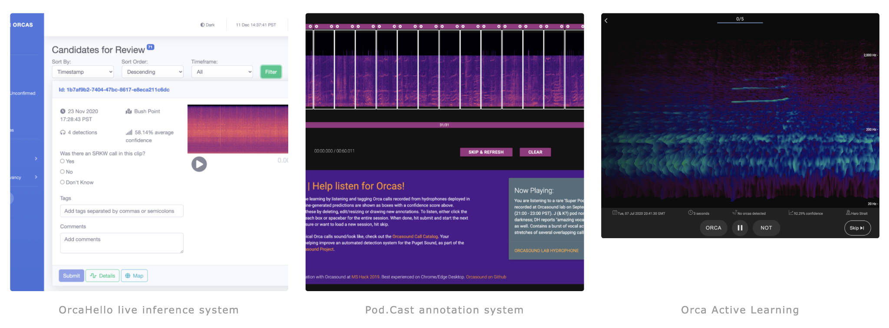
Artificial Intelligence for orcas
AI for orcas (#ai4orcas) -- ai4orcas.net -- OrcaHello | Pod.Cast | OrcaAL
towards (more) open (marine) bioacoustic data science...

Slide 10
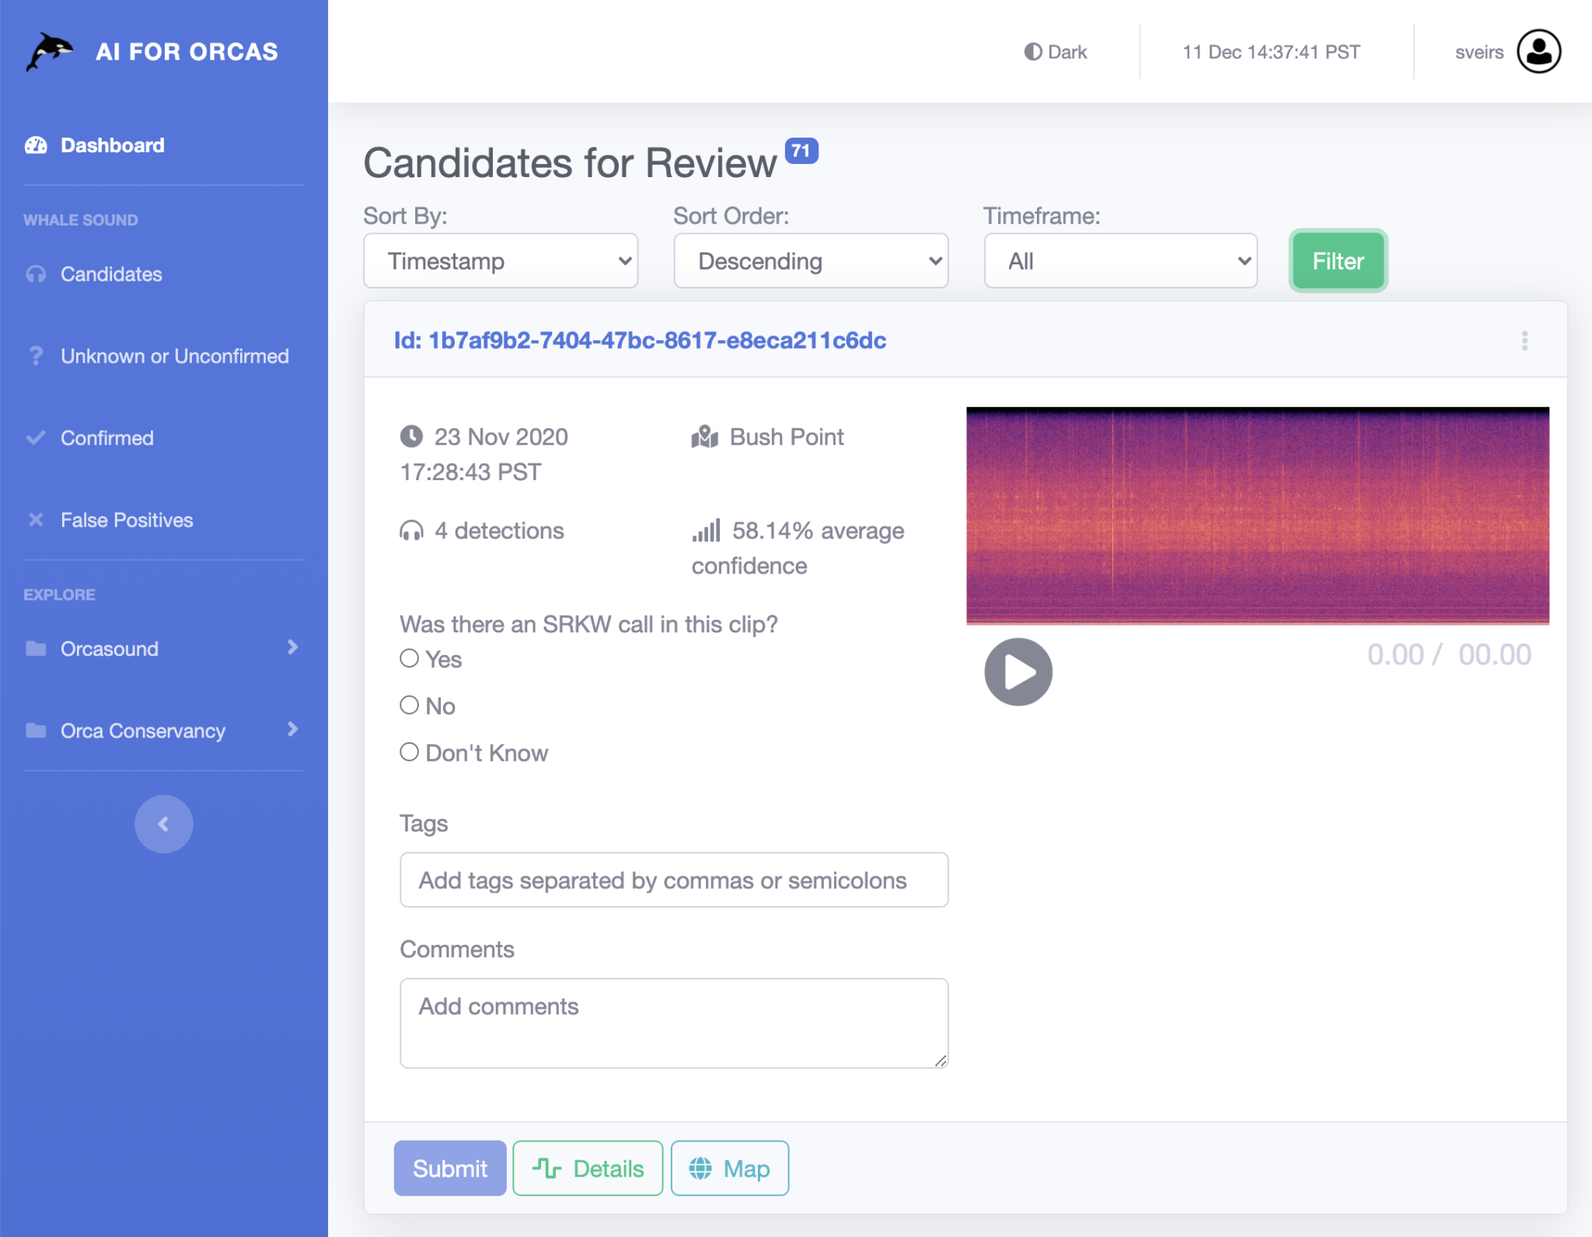
AI+human detection is optimal
For many end-users, expert validation of acoustic &/or visual detections is still important.
2021 results:
71 hr SRKW bouts
30 hr Bigg’s bouts
18 hr humpback bouts
Of 41 known SRKW transits: AI detected 54%; humans 81%; and 100% combined
AI outage in Oct missed 12 (31%)

Slide 11
Technical and scientific challenges
Where are they now?
Applied conservation problems
Can we automate reliable real-time notification of SRKW presence, or will humans remain in the loop?
Notify as soon as possible, or only when “sure” of SRKW?
What is end-user’s false positive tolerance?
The conservation challenge: how to inspire users to act for SRKWs when empathy is maximized during a live acoustic event?
What are they saying?
Basic biology problems
Bioacoustics topics our data can inform:
marine mammal communication systems
biosonar
marine acoustic ecology
soundscape analysis
Lots of visualization opportunities!

Slide 12
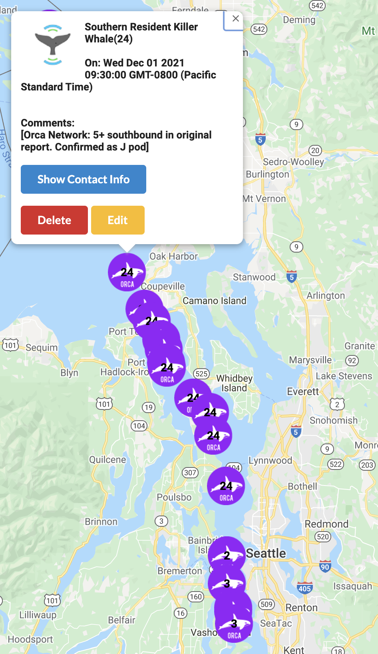
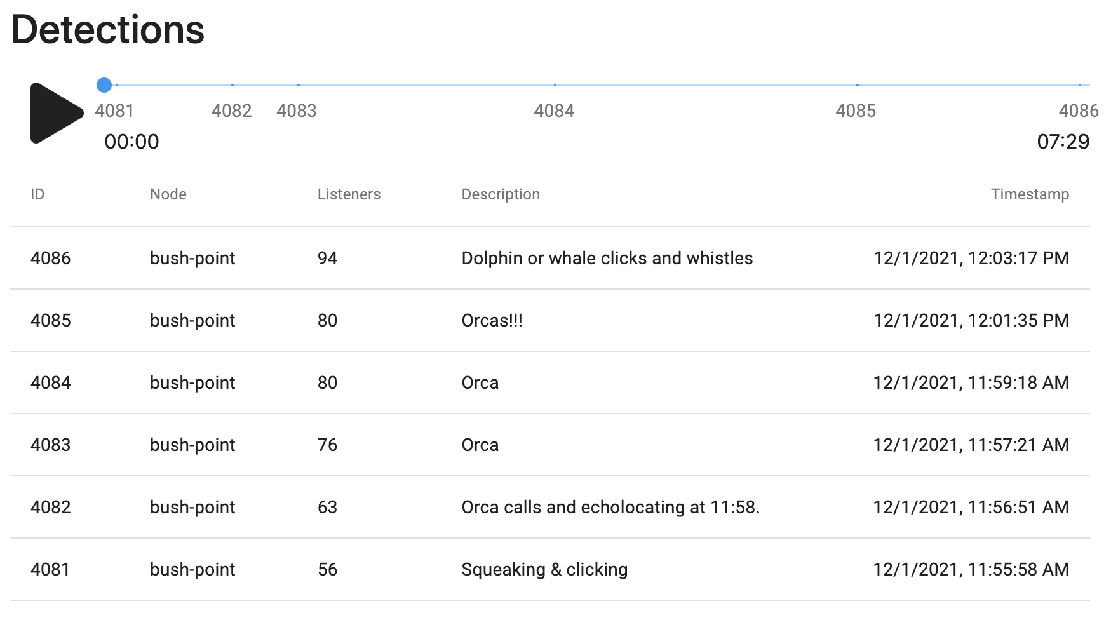
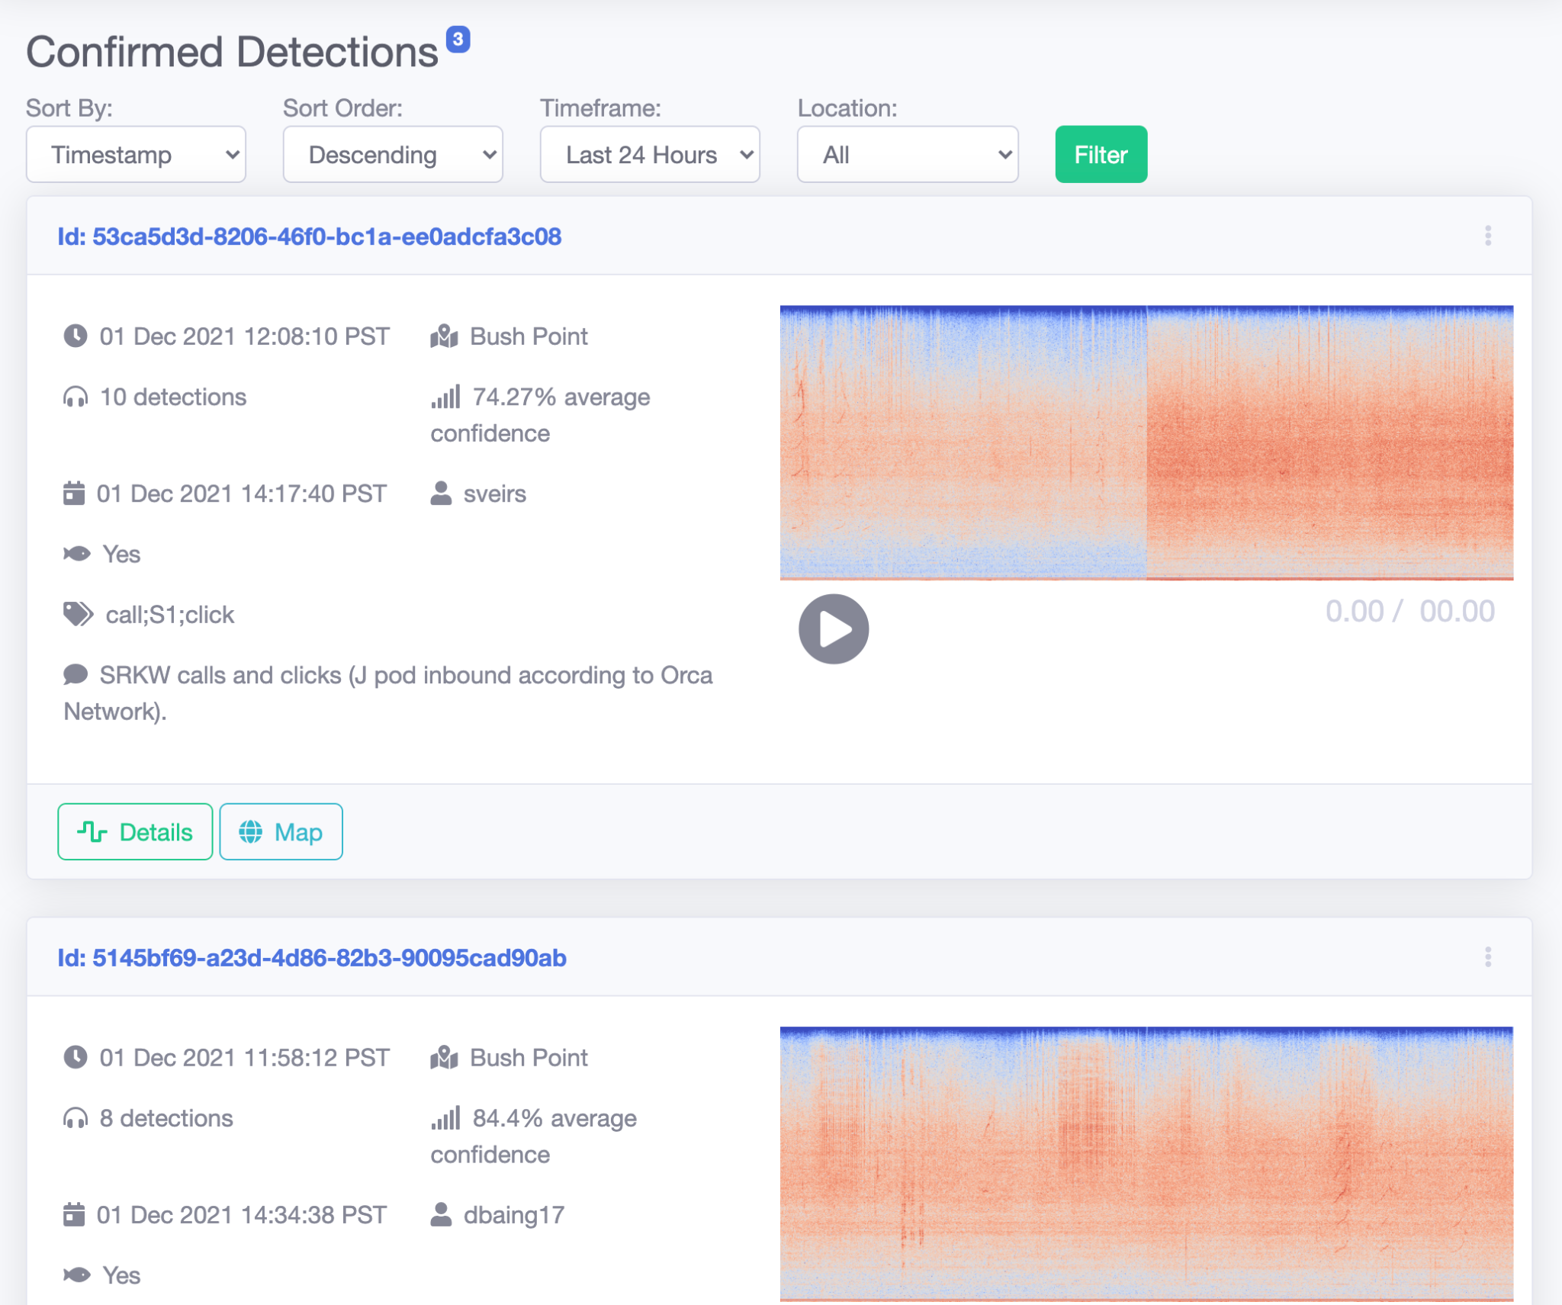
Sighting & listening together
Great synergies lie in integrating acoustic and visual real-time observations!
2022 goals:
Data cooperative for sharing:
  vetted sightings
  verified human detections
  moderated OrcaHello detections
Public API & Creative Commons license
Notifications API
Orca Network Facebook group

Slide 13
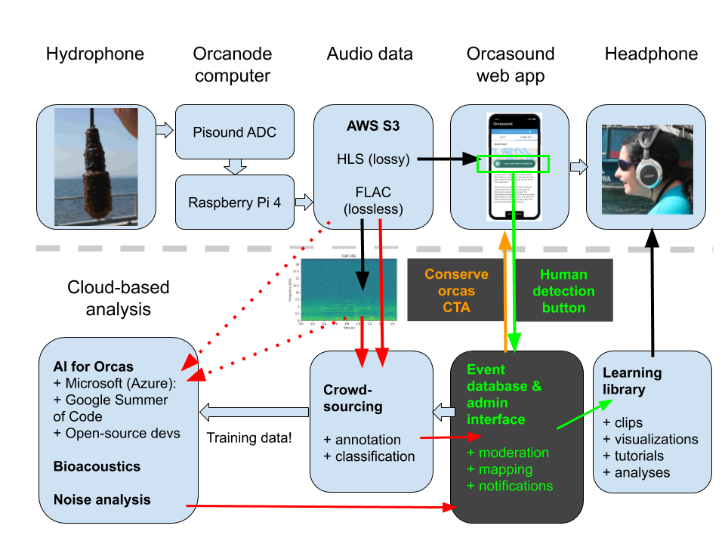
2022 challenge: Saving SRKWs & salmon
Will users label, heed a Conservation Call To Action, or both?
1800 subscribers
Baseline survey via subscription form
Conservation effect survey
Guiding principles:
User-centered design
Open roadmap (Trello)

Slide 14
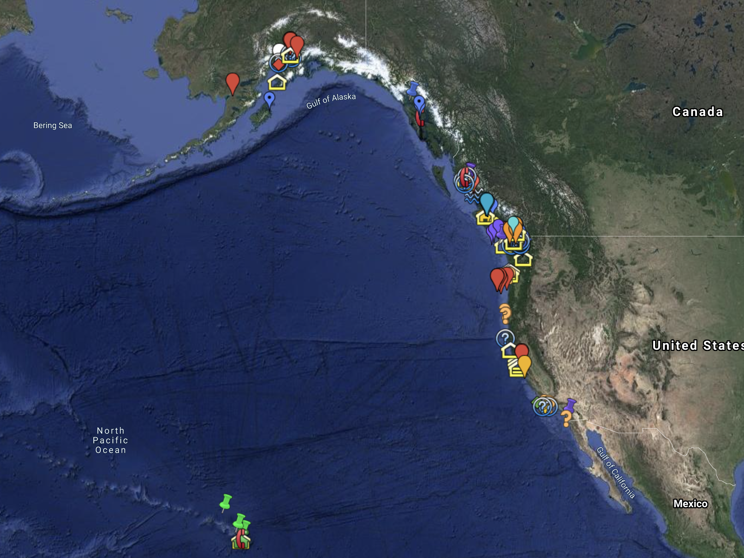
Grand challenge: sharing solutions globally
There are lots of soniferous species that need a voice!
Expansion possibilities for our open source solutions:
More SRKW nodes (U.S.)
SRKW nodes in Canada
Separate networks in other regions of the world (map) for other species? (belugas?!)
Explore our Google map of
NE Pacific hydrophones

Slide 15
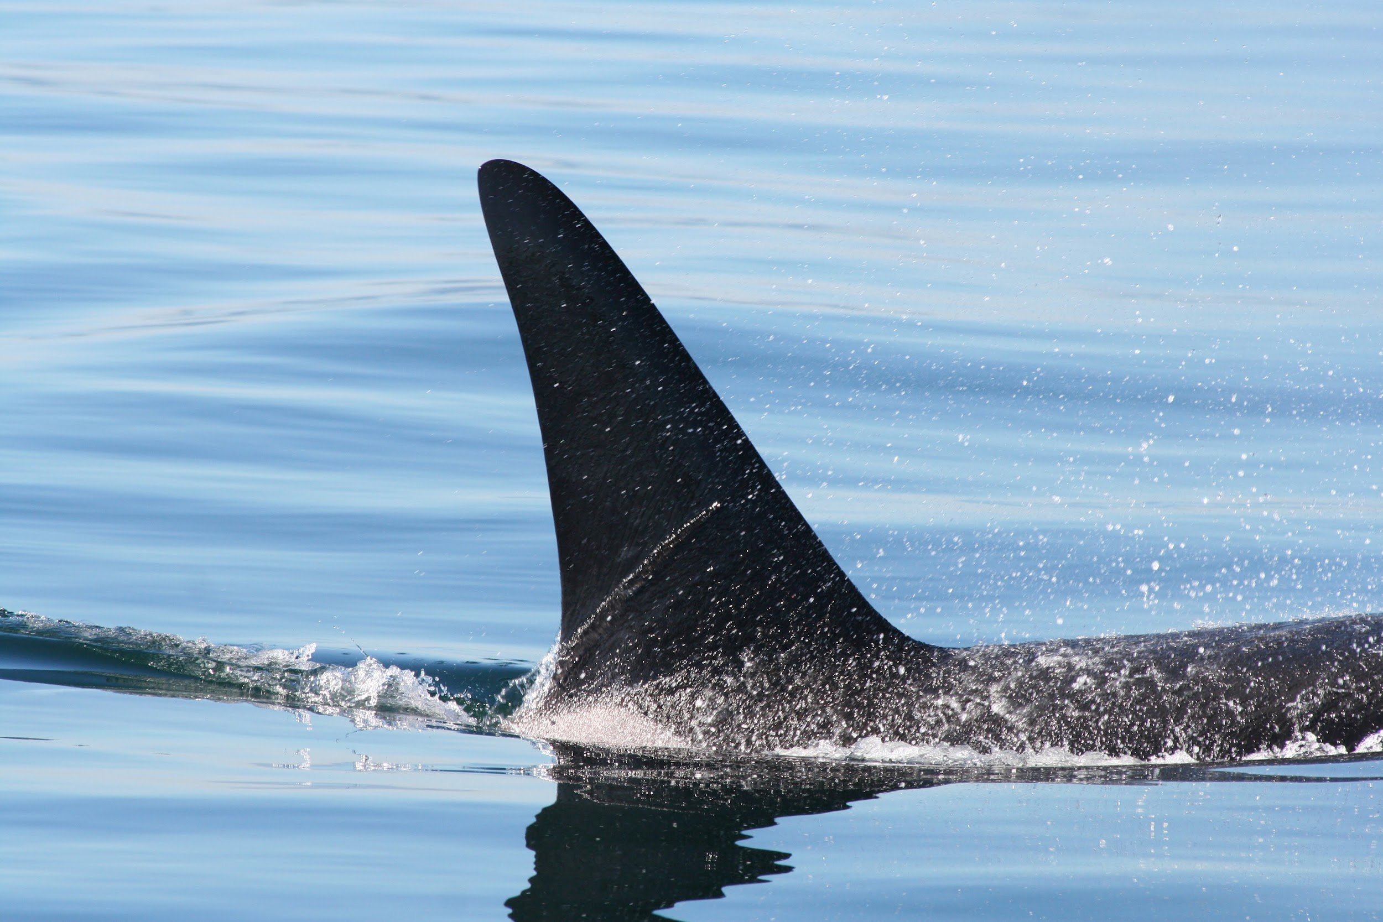
Acknowledgements & links
Give orcas a voice!
live.orcasound.net
Thanks to all our collaborators!
The Orcasound open source community’s volunteer hackers
The many NGOs & volunteers who maintain the hydrophones at each node
Google Summer of Code
Microsoft AI for Earth
More info:
orcasound.net
ai4orcas.net
github.com/orcasound

Slide 16
Extra slides...
From other Orcasound talks...

Slide 17
Extra discussion topics:
Practical detection vs miss rates
From candidate table
“False alarm”
Talk about false positive rate (10 per day)
About right winter 2021
Uncomfortable in spring (pigeon guillemot)
Too low in summer (ACI bugs)
Still too low/slow in fall?
Just right this winter?
User info
Adrian plots (e.g. subscriber growth?)
Geographic partitioning

Slide 18
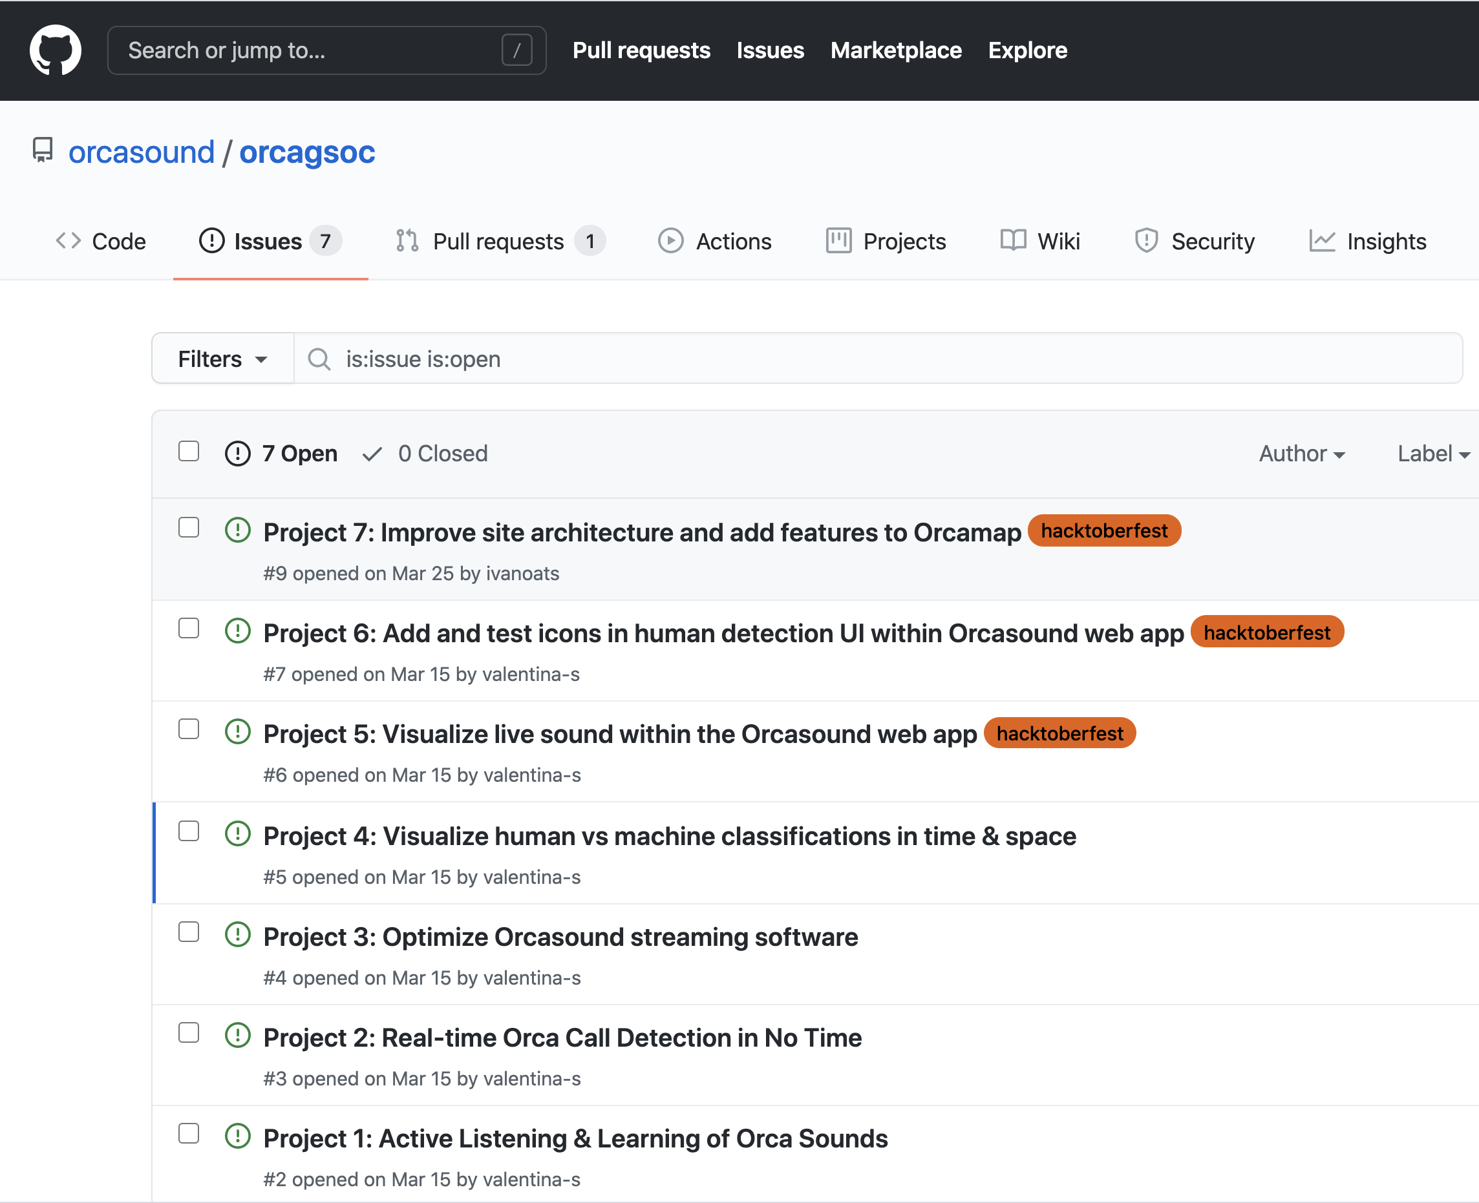
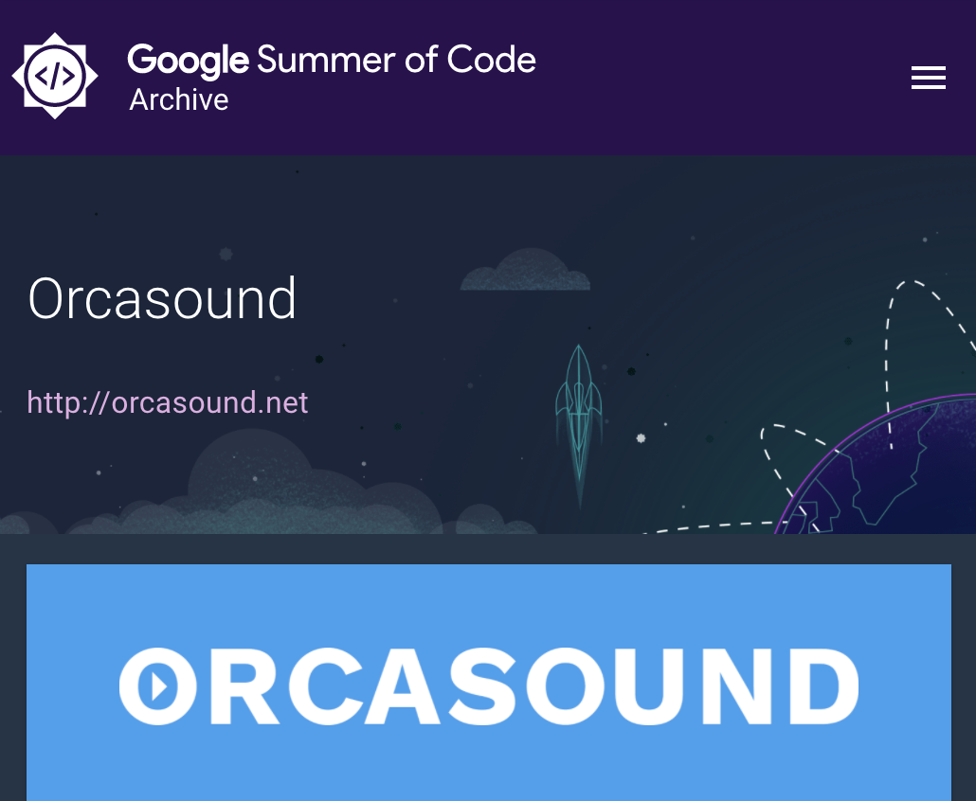
Orcasound & Google Summer of Code
GSoC: supports students & open-source software projects, like Orcasound
2019: OrcaCNN for Alaskan killer whale calls
2020: Build a tool to speed up the labeling of SRKW calls

Slide 19
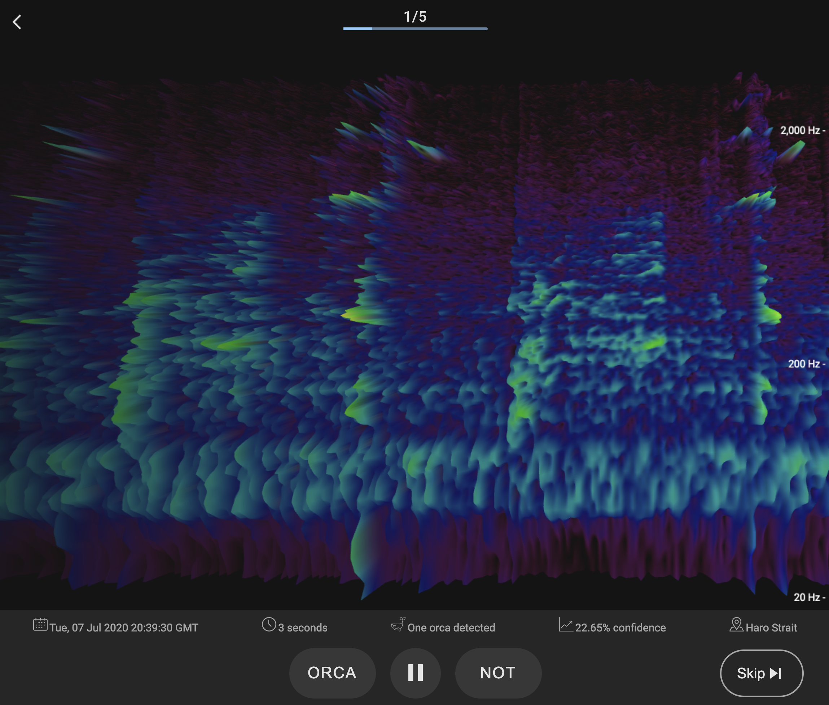
Orca active learning (OrcaAL)
Demo of the new citizen-science labeling tool!
Train a deep learning algorithm on an initial small labeled dataset
Use “uncertainty sampling” strategy to label only those samples for which the model is most uncertain (i.e. samples with confidence near 0.5)
Integrate model training, sample selection, and annotation in an AL tool.
Motivating question: How much does labelling a subset of the samples increase accuracy?

Slide 20
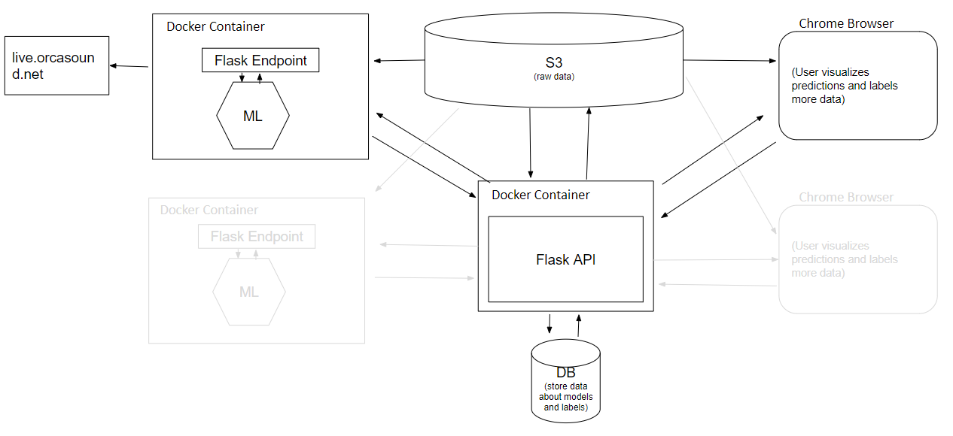
OrcaAL’s architecture
Open-source tools:
Chrome Experiments (3D spectrogram)
Docker
PostgreSQL
Flask
Notes:
This is all deployed on the cloud

